Slide 1

Pseudo Random Number Generators
Group 7: Daniel Briseno, Nick Steltzner, Dimitri Josifoski

Slide 2

Application 1: Estimating $π$ in Python
Python’s random module uses the Mersenne Twister (MT19937) PRNG
Uses the Mersenne prime 2^19937 – 1 as its period length which means the sequence won’t repeat itself for a very long time
Keeps a large internal state of 624 numbers
This algorithm uses matrix multiplication to generate random sequences which involves bit shifting, masking , and XOR operations on the numbers to produce a result
Generates 53‑bit floating‑point numbers uniformly in [0,1)
The uniformity of this algorithm ensures that points are evenly distributed in the square
The Mersenne twister algorithm should not be used for security purposes as it is not cryptographically secure, meaning one could predict future outputs from this algorithm

Slide 3
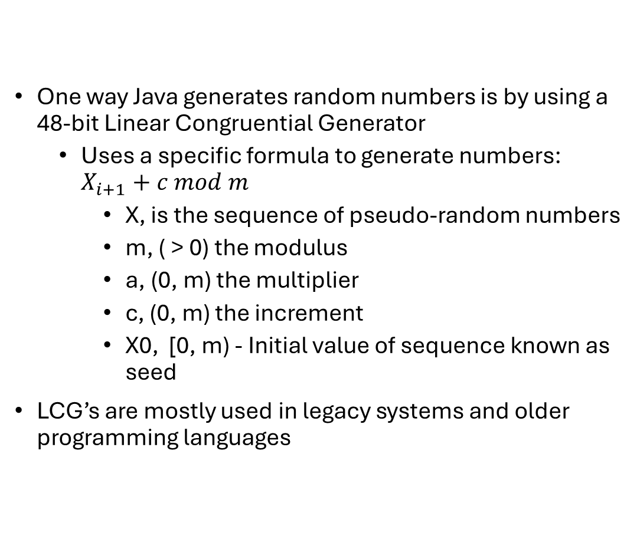

Application 1: Estimating $π$ in Java
One way Java generates random numbers is by using a 48-bit Linear Congruential Generator
Uses a specific formula to generate numbers: $X_{i+1}+c mod m$
X, is the sequence of pseudo-random numbers
m, ( > 0) the modulus
a, (0, m) the multiplier
c, (0, m) the increment
X0, [0, m) - Initial value of sequence known as seed
LCG’s are mostly used in legacy systems and older programming languages

Slide 4
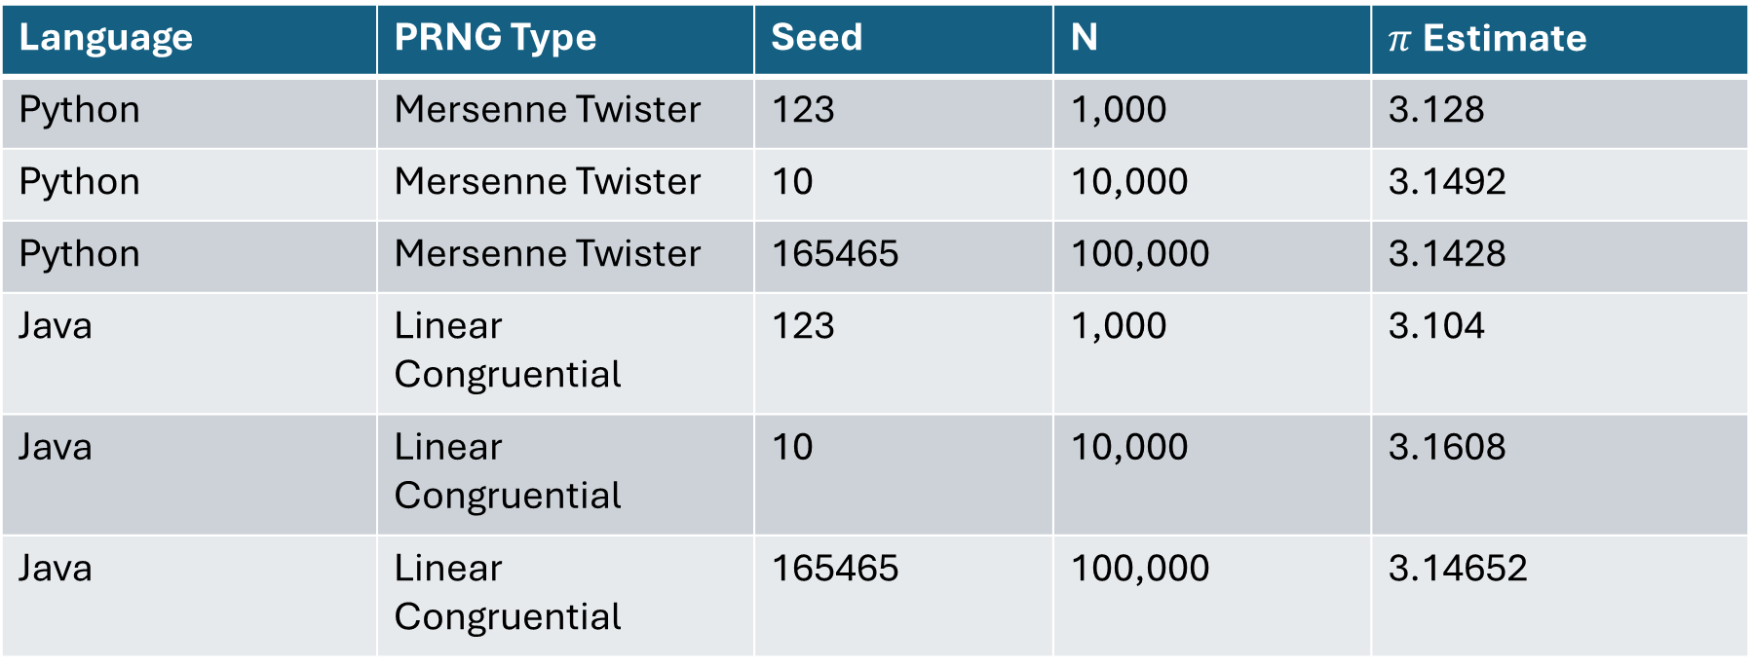
Application 1: Results
Language | PRNG Type | Seed | N | $π$ Estimate
Python | Mersenne Twister | 123 | 1,000 | 3.128
Python | Mersenne Twister | 10 | 10,000 | 3.1492
Python | Mersenne Twister | 165465 | 100,000 | 3.1428
Java | Linear Congruential | 123 | 1,000 | 3.104
Java | Linear Congruential | 10 | 10,000 | 3.1608
Java | Linear Congruential | 165465 | 100,000 | 3.14652

Slide 5
Application 1: Insights
Small vs large N
Estimates fluctuate more when N is smaller
As N increases, the estimates stabilize and converge toward π
Seed effects
Changing the seed would produce a different sequence and slightly different π estimate.
Seed value changes the sequence, not the statistical quality

Slide 6
Application 1 Insights continued
Language differences
Python (Mersenne Twister):
High-quality PRNG with long period and strong statistical properties.
Estimates are more stable and closer to π even at small N.
Java (LCG):
Simpler PRNG with shorter period and weaker statistical properties.
Estimates fluctuate more, especially at small N.
Insight:
Python’s Mersenne Twister outperforms Java’s LCG in consistency and convergence

Slide 7
Application 2: Generating a Permutation of 1 to 50 in JavaScript
JavaScript — mulberry32 (Seeded PRNG)
Simple seeded PRNG (deterministic)
Uses bitwise mixing (XOR/shifts/multiply)
Same seed = same output (reproducible)
Good for: demos / reproducible shuffles
Not for: security

Slide 8
Application 2: Generating a Permutation of 1to 50 in Java
Java — Random (LCG)
Uses Linear Congruential Generator (LCG)
Fast, small internal state
Same seed = same sequence (reproducible)
Good for: sims / shuffles / testing
Not for: security (predictable)

Slide 9
Application 2: Methodology + Insights
Permutation Method: Fisher–Yates Shuffle
Start with [1..50]
For i = 49 → 1: choose j ∈ [0..i], swap a[i] and a[j]
Run twice: fixed seed + random seed
Record first 7 numbers
Insights:
Fixed seed = reproducible (same permutation every run)
Same seed, different languages → different results (different PRNG algorithms)
Fisher–Yates gives roughly uniform positions if j is chosen uniformly

Slide 10
Application 2: Generating a Permutation of 1to 50 - Results
Language | PRNG Type | Seed | N | First 7 (“Estimate”)
JS | mulberry32 (seeded PRNG) | 123456789 | 50 | 36, 25, 8, 23, 24, 11, 30
JS | mulberry32 (seeded PRNG) | 4098596455 | 50 | 14, 2, 9, 26, 16, 27, 36
Java | java.util.Random (LCG) | 123456789 | 50 | 29, 35, 46, 33, 10, 34, 11
Java | java.util.Random (LCG) | -3380858092892129405 | 50 | 30, 10, 37, 45, 47, 14, 42

Slide 11
Additional References and AI Usage
References Used:
We used a collection of different websites, such as Geeks for Geeks and Stack Overflow to accomplish the required objectives.
Linear Congruence method for generating Pseudo Random Numbers - GeeksforGeeks
Unraveling the Mystery: How Does the Mersenne Twister Work? – SoftHandTech
https://stackoverflow.com/questions/30807010/how-to-increase-the-performance-for-estimating-piin-python
AI Usage:
We used AI tools such as ChatGPT and Copilot to review our code for quality, strengthen our understanding of PRNG algorithms, and check our slides to ensure we followed the project guidelines and maintained clear, correct grammar.

